Slide 1
Session 6
Functions

Slide 2
Session objectives (1)
Understand what functions do
Identify the function structure
Discuss the arguments of a function
Discuss return from the function
Discuss the type of a function
Identify function declaration
Identify function prototype
Discuss more on variables

Slide 3
Session objectives (2)
Recognize the scope rules for a function
Understand the sizeof() operator
Discuss call by value and call by reference
Explain recursive functions
Identify storage classes
Discuss functions in multifile programs
Explain function declaration
for extern functions

Slide 4
Benefits of Functions
Large tasks can be broken up into manageable units
Repetitive tasks can be simplified
Functions are loops

Slide 5
Using functions
#include<iostream.h>
void main(void)
{
:
func1() ;
func2() ;
:
}
func1()
}
{
:
}
func2()
{
:
The program component
main()
is also considered
a function

Slide 6
Structure of a Function
Attributes of a function
A name that identifies it
The type of the value returned by the function
The function’s parameters and their data types
return data type function_name(parameter type [parameter name])
{
Processing statements
}

Slide 7
Calling a Function (1)
main()
{
func1();
}
func1()
{
:
:
}
Calling function is main()
Called function is func1()

Slide 8
Calling a Function (2)
#include <iostream.h>
#include <conio.h>
void main(void)
{
void first_function() ;
first_function() ;
}
void first_function()
{
cout << "Writing my first C++ function !!!" ;
}
Writing my first C++ function !!!

Slide 9
Arguments (1)
also known as parameters
Data passed between functions
There can be more than one argument
seperate them by commas

Slide 10
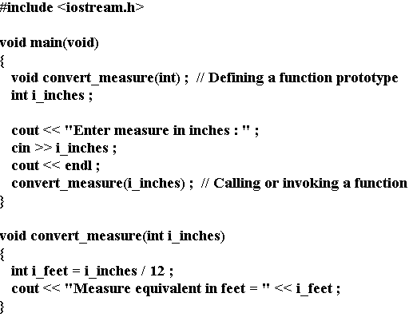
Arguments (2)

Slide 11
Return from functions (1)
A function can return a value
to its calling function
Keyword used is return
Functions with the return data type ‘void’
do not return any value

Slide 12
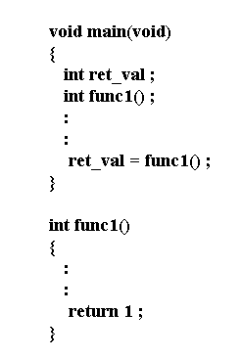
Return from functions (2)

Slide 13
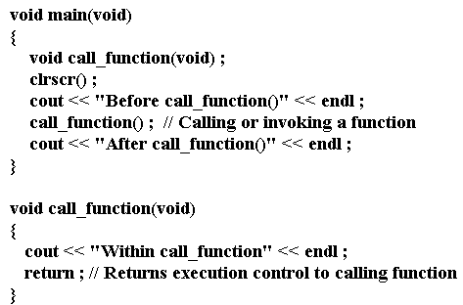
Return from functions (3)
No return
data type

Slide 14
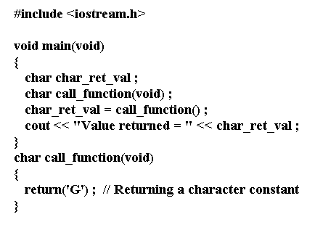
Return from functions (4)
Character values can be returned

Slide 15
Scope of Variables (1)
scope
Depends upon the
location in the program

Slide 16
Scope of Variables (2)
Variables
Local
Variables
Global
Variables

Slide 17
Scope of Variables (3)
Variables defined within a function,
can be accessed and modified within that function
Variables not defined within any function,
can be accessed and modified by all the functions in that program

Slide 18
Scope of Variables (4)
int gi_area; // Declaring a global variable
void main(void)
{ void using_globalvar(void);
void g_func(void) ;
int li_len, li_wid; //Declaring local variables
:
:
using_globalvar() ; //Function call
}
void using_globalvar(void)
{
cout << "\nArea = " << gi_area; // Global variable
getch() ;
return ;
}

Slide 19
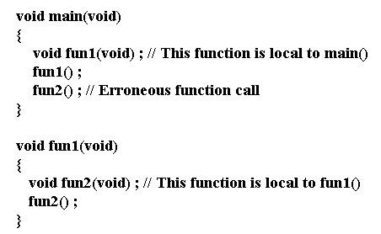
Scope of functions (1)
If a function is declared within a function body,
its scope is limited to the function within which it is defined

Slide 20
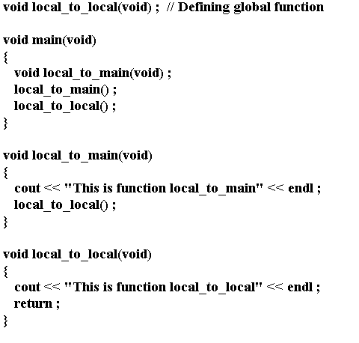
Scope of functions (2)
If a function is declared outside any function, then it becomes
accessible to all of the functions within the program.

Slide 21
Actual and Formal parameters (1)
The parameter specified during a function call
Actual parameter ( argument )
The corresponding parameter in the called function
Formal parameter ( argument )

Slide 22
Actual and Formal parameters (2)
#include <iostream.h>
void main(void)
{
void test_function(int) ;
test_function(1) ; \\ actual parameter
}
Void test_function(i_recd_value)\\formal parameter
int i_recd_value ;
{
cout << "Value passed = " << i_recd_value ;
return ;
}

Slide 23
Default Arguments
#include <iostream.h>
int called_function(int i1=1,int i2= ,int i3=1,int i4=1) ;
void main(void)
{
called_function(10, 10, 10, 10) ;// Call with parameters
called_function() ;//Without parameters using default parameters
}
}
int called_function(int i1, int i2, int i3, int i4)
{
cout << i1 << endl << i2 << endl << i3 << endl << i4 ;
return 1 ;
}
A default argument is a value automatically
assigned to a formal variable if the actual
argument from the function call is omitted

Slide 24

The sizeof() operator (1)
unary compile time operator
returns the length of the variables in bytes

Slide 25
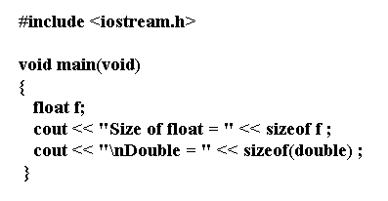

The sizeof() operator (2)

Slide 26
Recursive functions (1)
Recursion is a process in which
a function calls itself repeatedly
until some specified condition is met
To solve a problem recursively
- the problem must be written in recursive form
- the problem must include a stopping condition

Slide 27
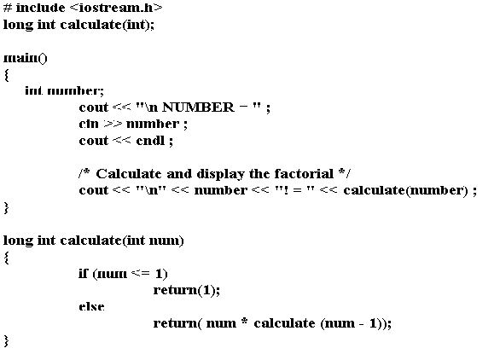
Recursive functions (2)

Slide 28
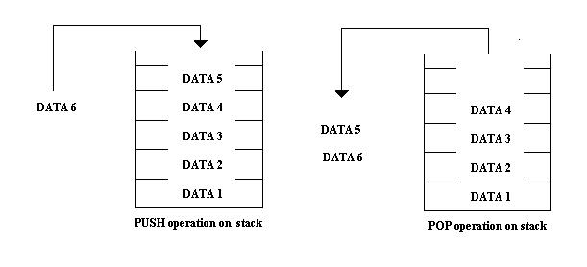
Recursive functions (3)
Execution of recursive functions
Different set of local variables are created for each call

Slide 29
Storage classes (1)
Automatic
Static
External
Register

Slide 30
Auto storage class
Automatic variables do not retain the
value over a number of function calls
Local variables are by default auto variables
To declare an automatic variable the keyword auto,
which is optional for local variables, is used

Slide 31
Static storage class (1)
Static variables retain their values
over a number of function calls
To declare a static variable the keyword static
is placed at the head of the declaration

Slide 32
Static storage class (2)
void print_auto(void)
{
static int i = 0 ;
auto j = 0;
cout << "\nValue of i before incrementing = " << i ;
cout << "\nValue of j before incrementing = " << j ;
i += 10 ;
j += 10 ;
cout << "\nValue of i after incrementing = " << i ;
cout << "\nValue of i after incrementing = " << j ;
}

Slide 33
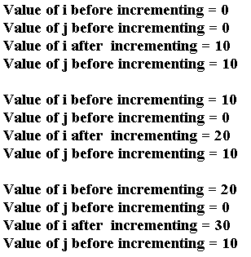
Static storage class (3)
void main(void)
{
clrscr() ;
print_auto() ;
cout<<”\n”;
print_auto() ;
cout<<”\n”;
print_auto() ;
}

Slide 34
Extern storage class (1)
A global variable located in file A
can be accessed by a function in file B
using the keyword extern

Slide 35
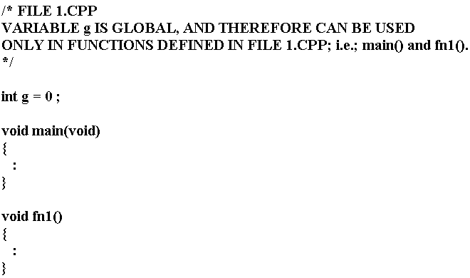
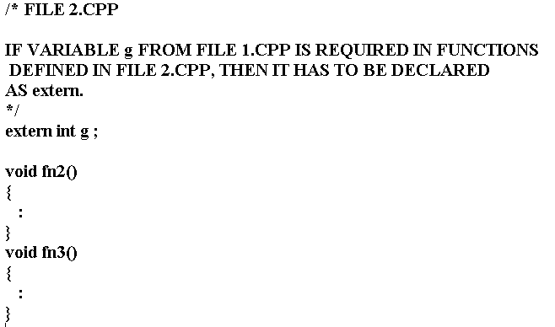
Extern storage class (2)

Slide 36
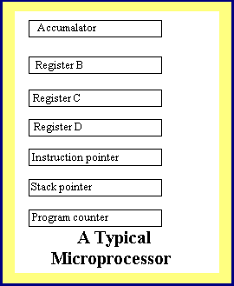
Register storage class
Register memory is a part of
microprocessor itself
Register storage class can be specified
only for local variables
For faster execution of programs
register storage class can be specified
Address operator ‘&’ cannot
be applied to register variables
register int number ;

Slide 37
Functions in multiple files
Programs can be composed of multiple files
Functions of the same program can be defined
in different files
As with variables in multifile programs,
functions can also be defined as static or external
static fn_type ( argument list )
extern fn_type ( argument list )

